Slide 1
Create a comprehensive presentation on cryptocurrency scams covering the landscape of digital asset fraud, including Ponzi schemes, pump and dumps, fake ICOs, rug pulls, phishing attacks, fraudulent exchanges, mining scams, giveaway frauds, and DeFi vulnerabilities, along with protection strategies involving technical safeguards, due diligence frameworks, and psychological defenses. Include relevant statistics, demographic insights, case studies of major incidents (like BitConnect, OneCoin, and the Squid Game token), and conclude with action steps for victims, emerging fraud trends, and additional resources to help audience members identify scams, understand their mechanics, and protect their digital assets in this rapidly evolving space the text should have image to describe it - Comprehensive Analysis
Strategic Insights and Forecast

Slide 2
Introduction to Blockchain
What is blockchain technology
Key principles: decentralization, immutability, and transparency
Evolution of blockchain technology

Slide 3

Introduction to Blockchain - Visual

Slide 4
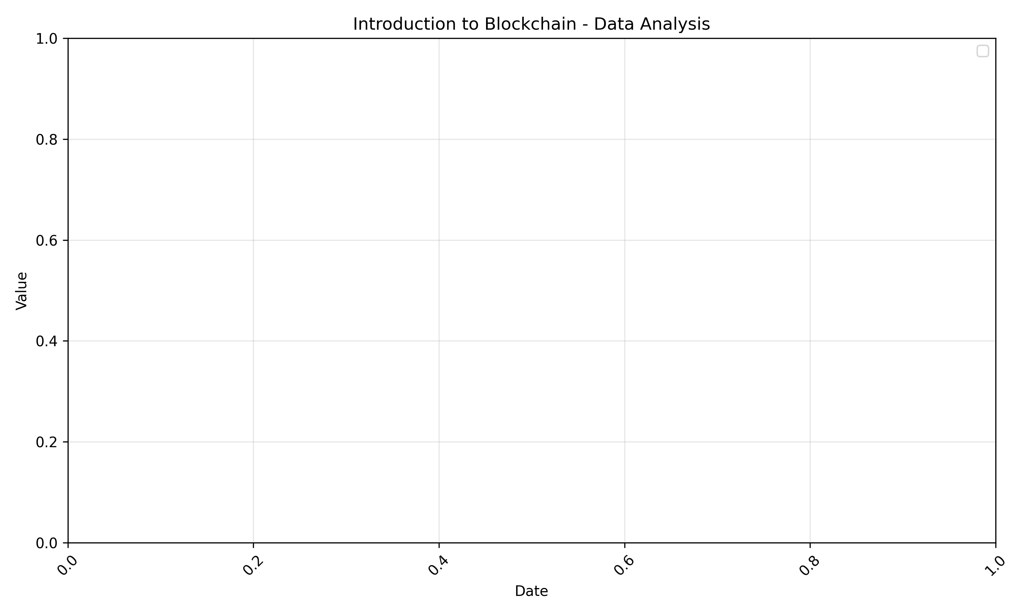
Introduction to Blockchain - Analytics
Data analysis with historical trends and forecast

Slide 5
Blockchain Architecture
Core components of blockchain systems
Consensus mechanisms (PoW, PoS, DPoS)
Smart contracts and decentralized applications

Slide 6
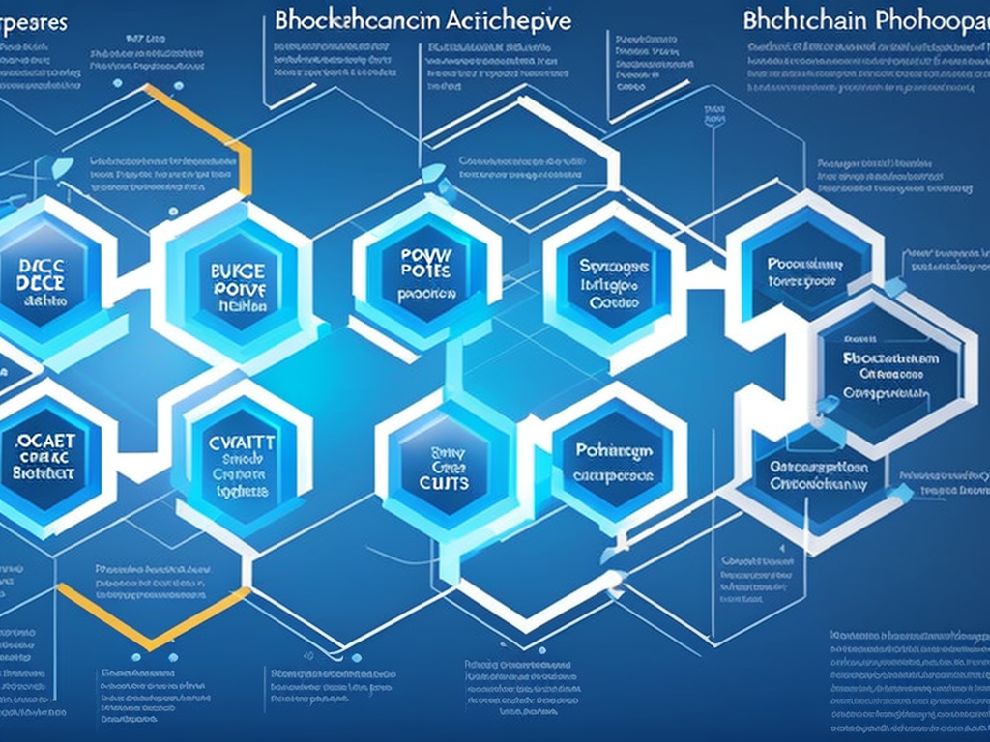
Blockchain Architecture - Visual

Slide 7
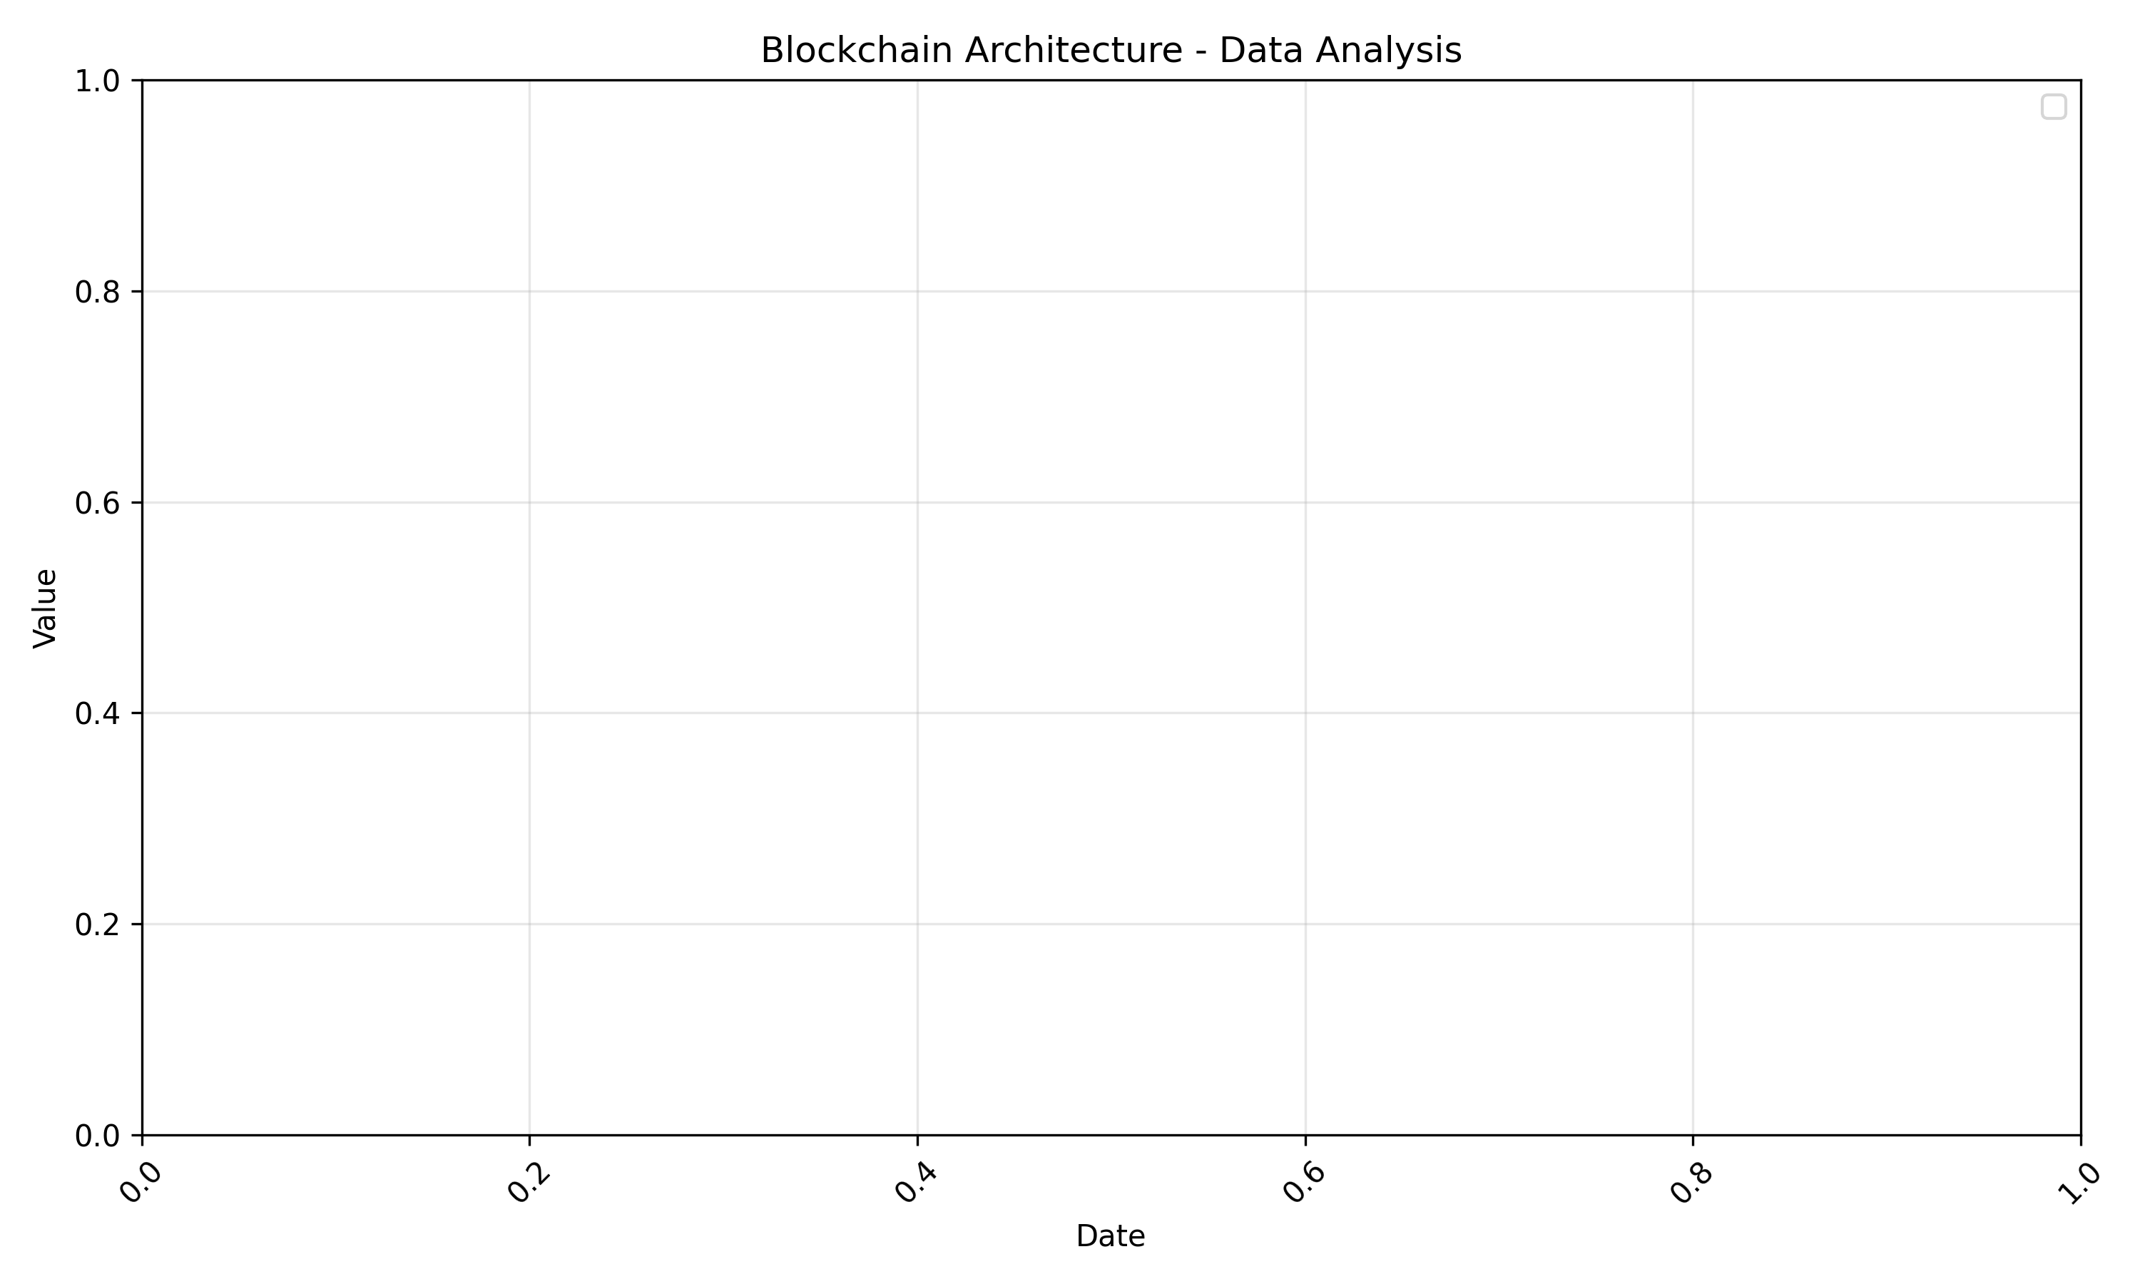
Blockchain Architecture - Analytics
Data analysis with historical trends and forecast

Slide 8
Market Analysis
Current blockchain market overview
Key players and platforms
Market size and growth projections

Slide 9
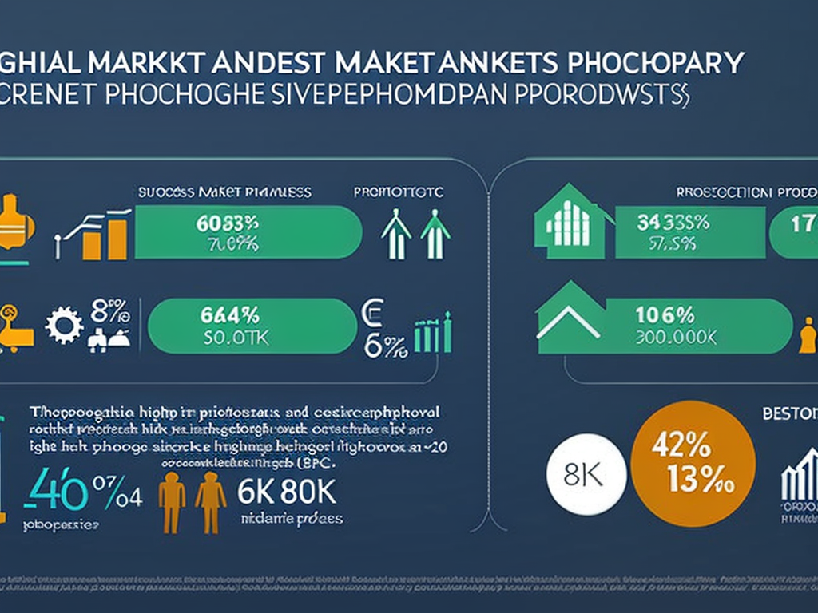
Market Analysis - Visual

Slide 10
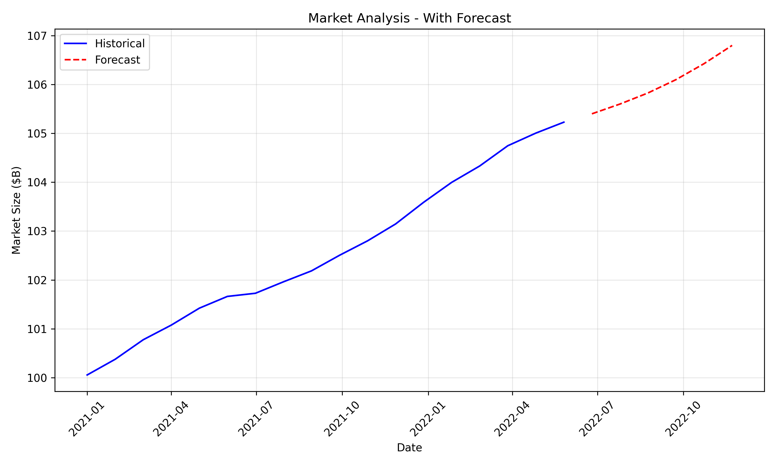
Market Analysis - Analytics
Data analysis with historical trends and forecast

Slide 11
Use Cases
Financial services applications
Supply chain management
Healthcare and identity management
Government and public sector applications

Slide 12

Use Cases - Visual

Slide 13
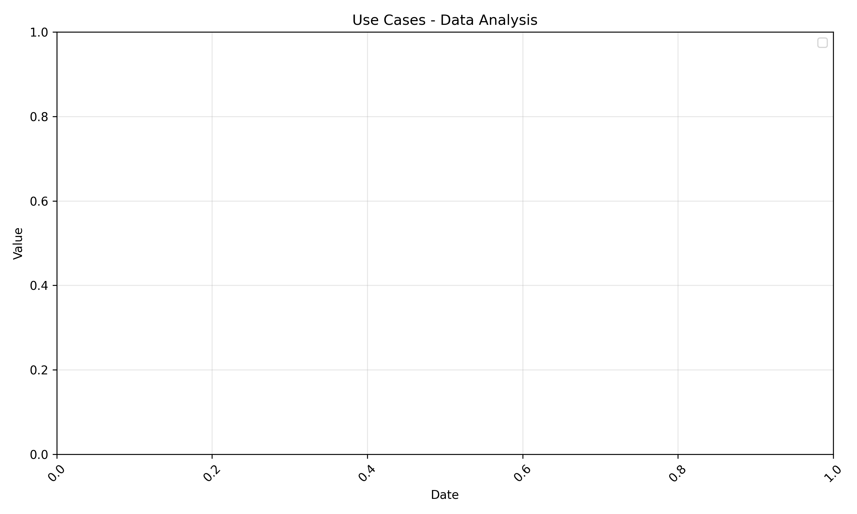
Use Cases - Analytics
Data analysis with historical trends and forecast

Slide 14
Cryptocurrency Trends
Major cryptocurrencies performance
Trading volume and market capitalization
Regulatory landscape and compliance

Slide 15
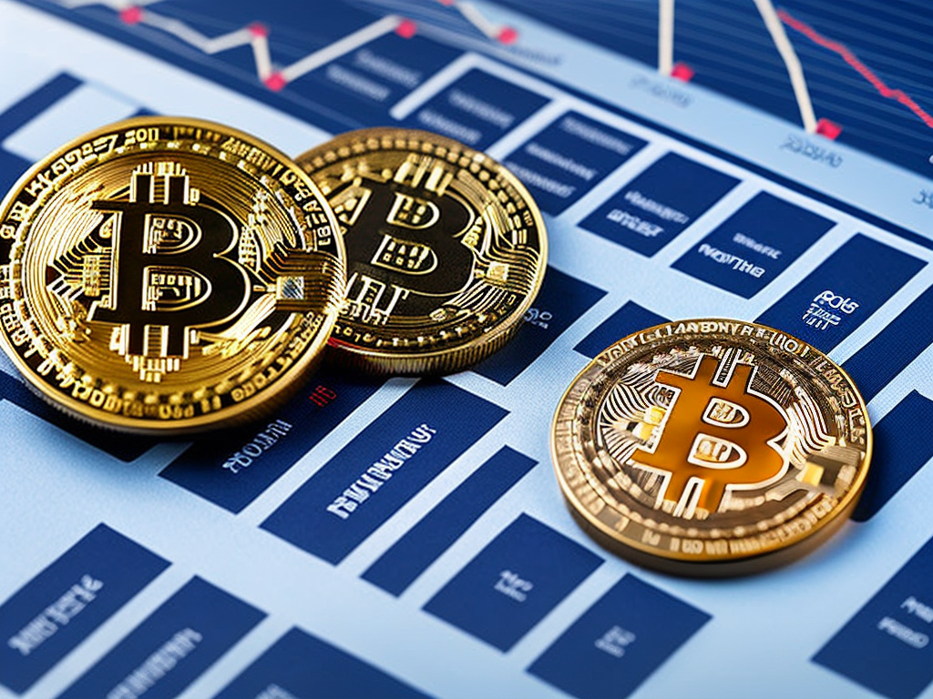
Cryptocurrency Trends - Visual

Slide 16
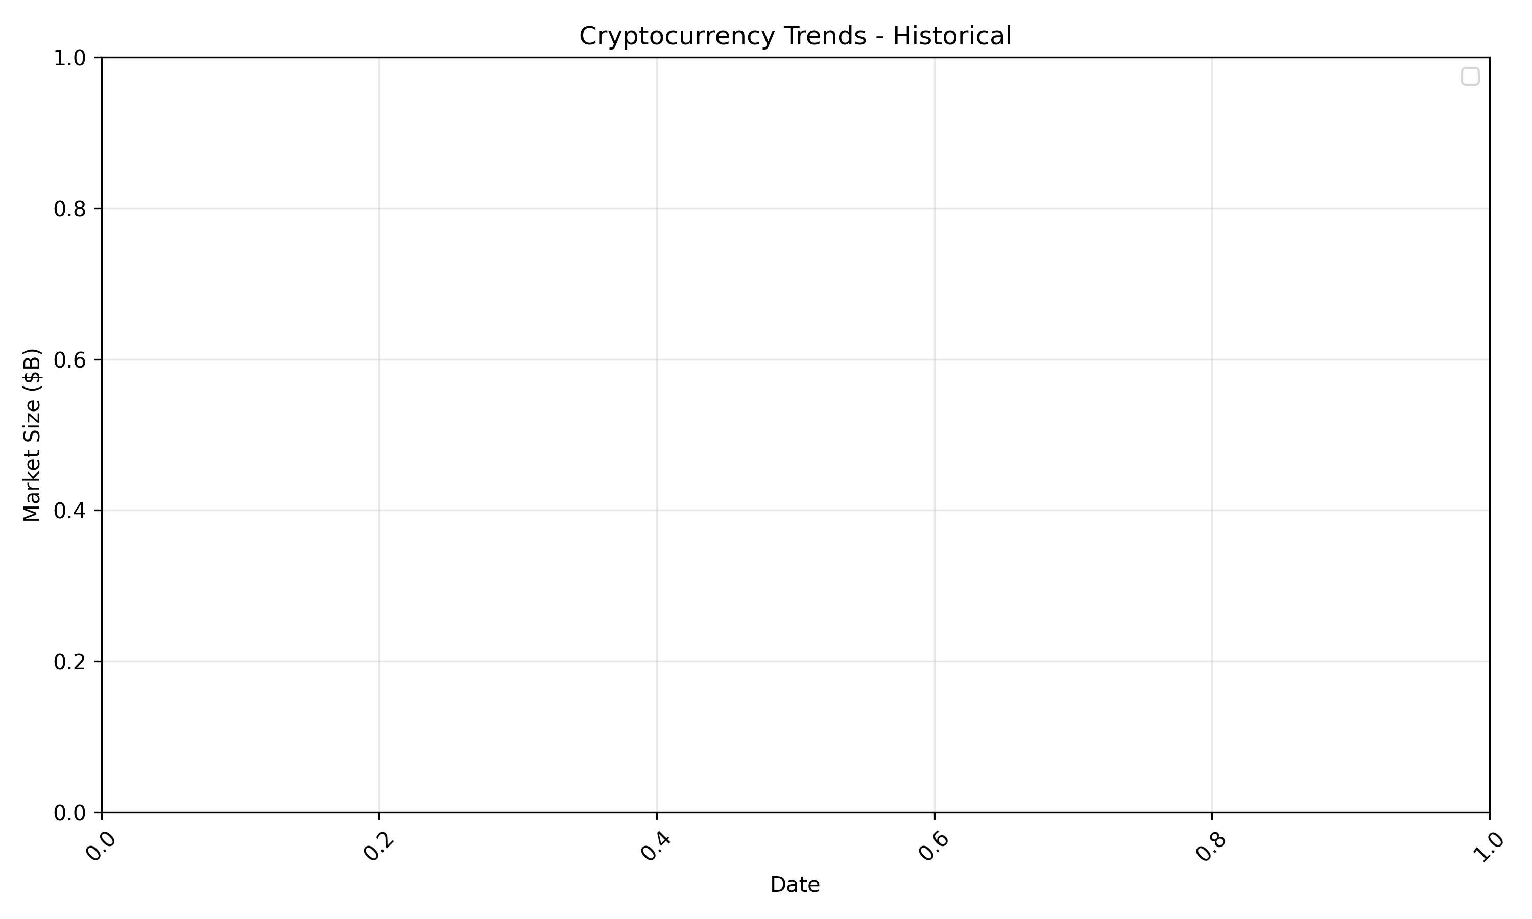
Cryptocurrency Trends - Analytics
Data analysis with historical trends and forecast

Slide 17
Technical Challenges
Scalability solutions
Energy consumption concerns
Interoperability between blockchains
Security considerations

Slide 18

Technical Challenges - Visual

Slide 19
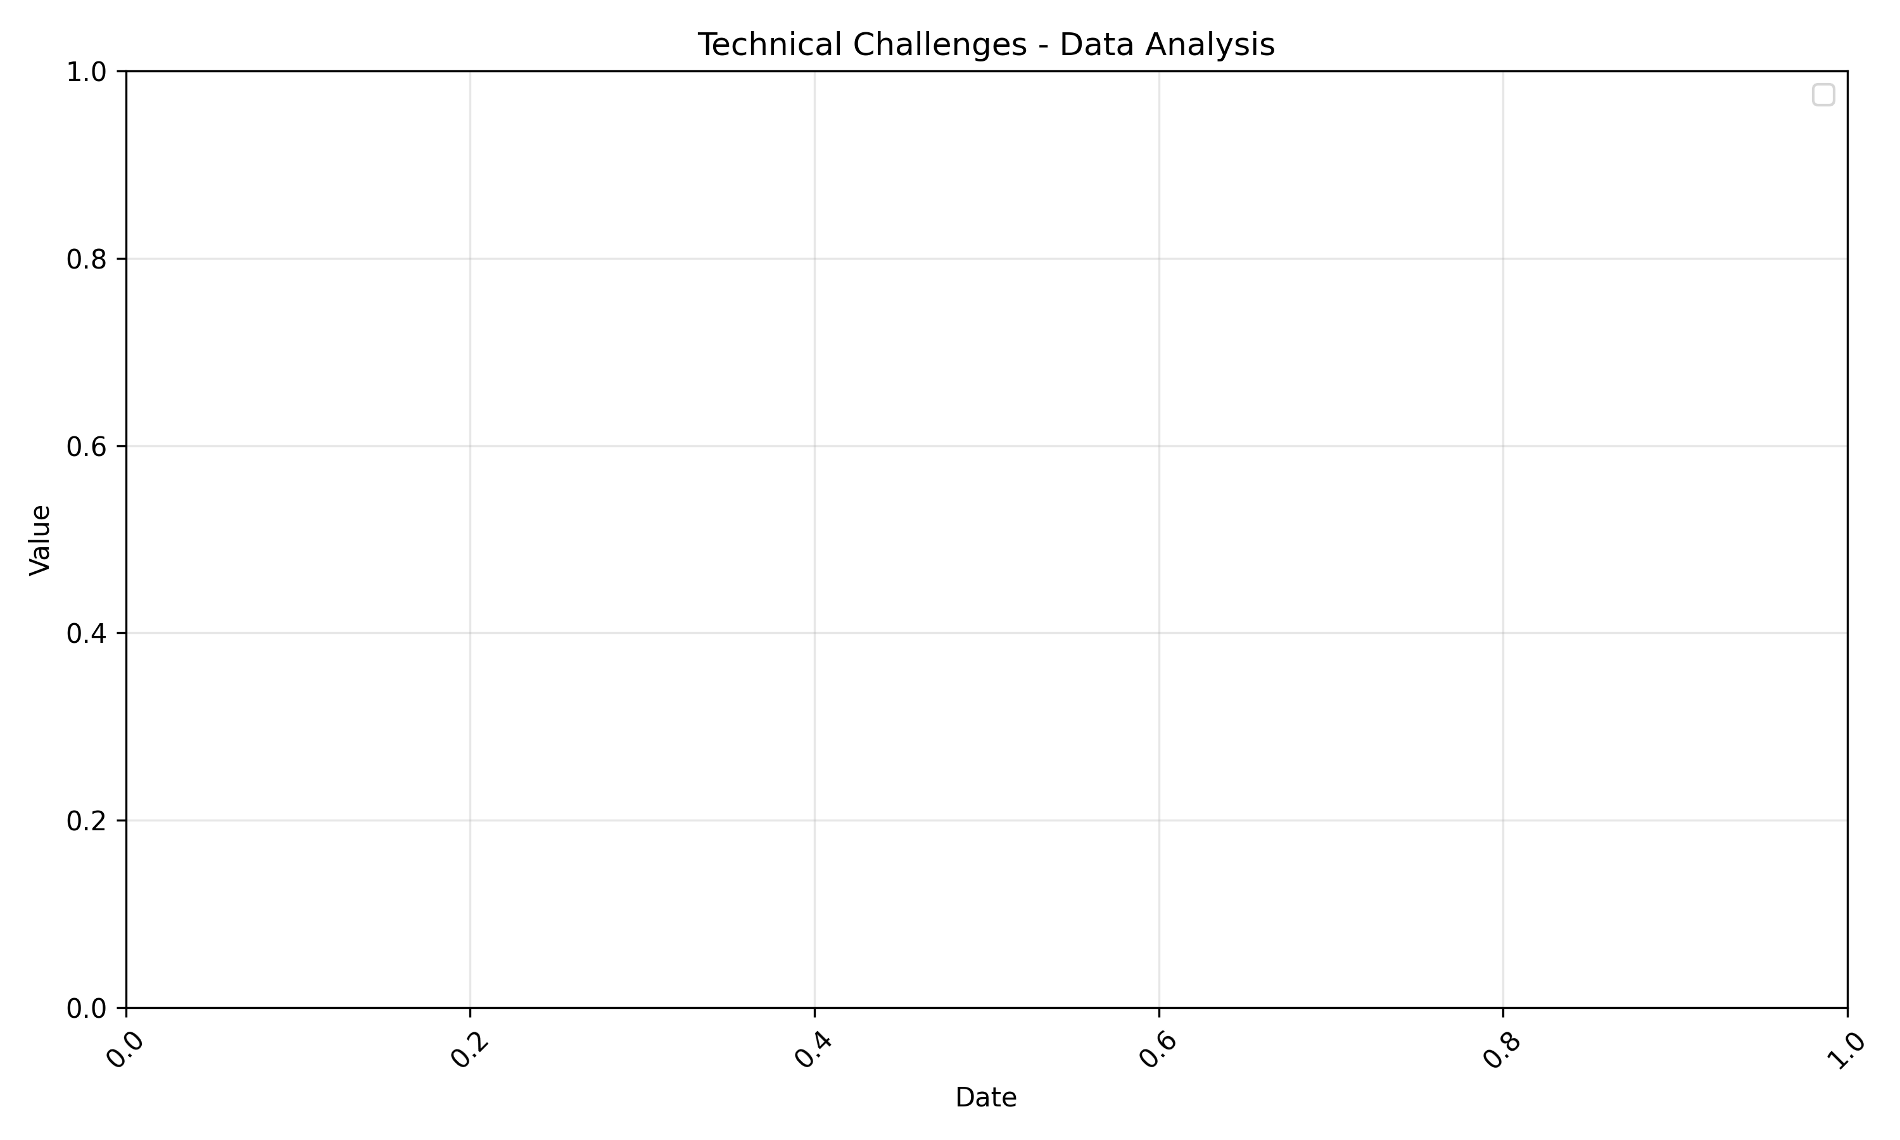
Technical Challenges - Analytics
Data analysis with historical trends and forecast

Slide 20
Implementation Framework
Blockchain selection criteria
Integration approaches with existing systems
Development and deployment considerations

Slide 21

Implementation Framework - Visual

Slide 22

Implementation Framework - Analytics
Data analysis with historical trends and forecast

Slide 23
Future of Blockchain
Emerging trends and innovations
Potential disruptive applications
Long-term industry forecast

Slide 24

Future of Blockchain - Visual

Slide 25
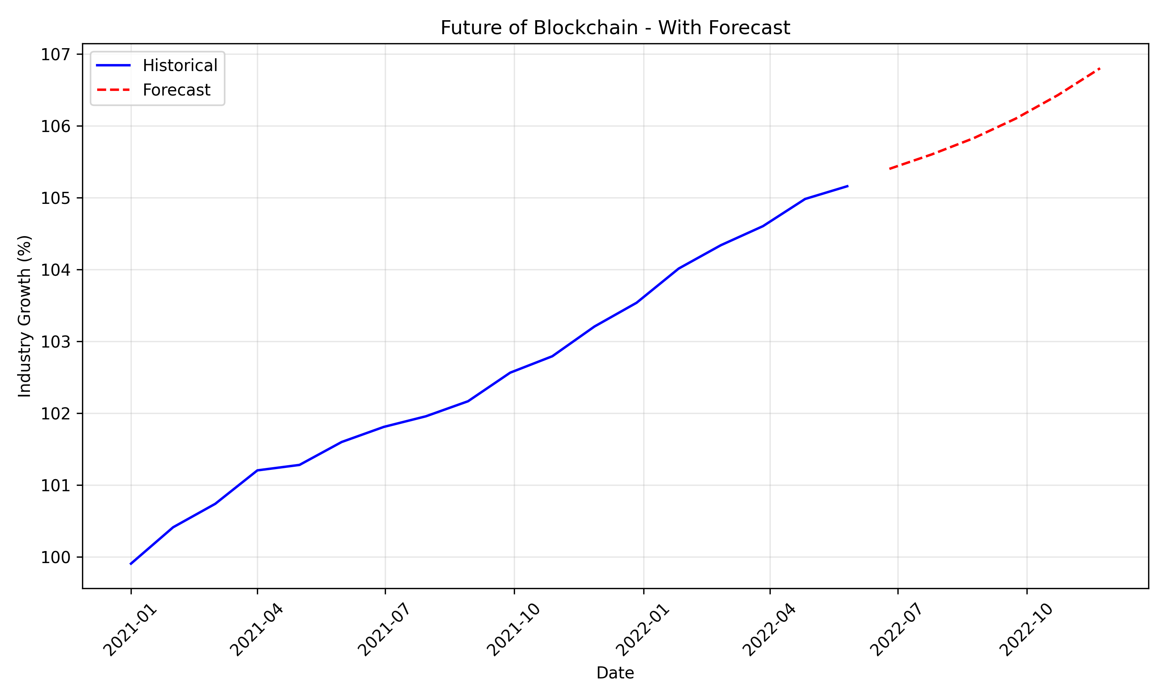
Future of Blockchain - Analytics
Data analysis with historical trends and forecast

Slide 26
Summary
Key takeaways from blockchain analysis
Strategic recommendations
Next steps and action plan

Slide 27
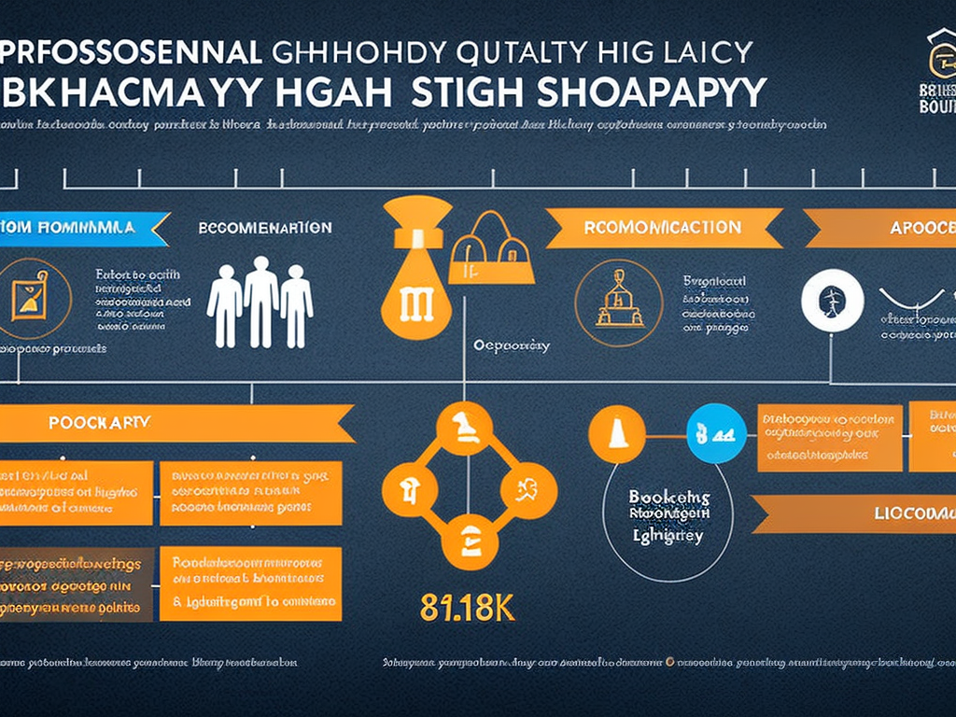
Summary - Visual

Slide 28
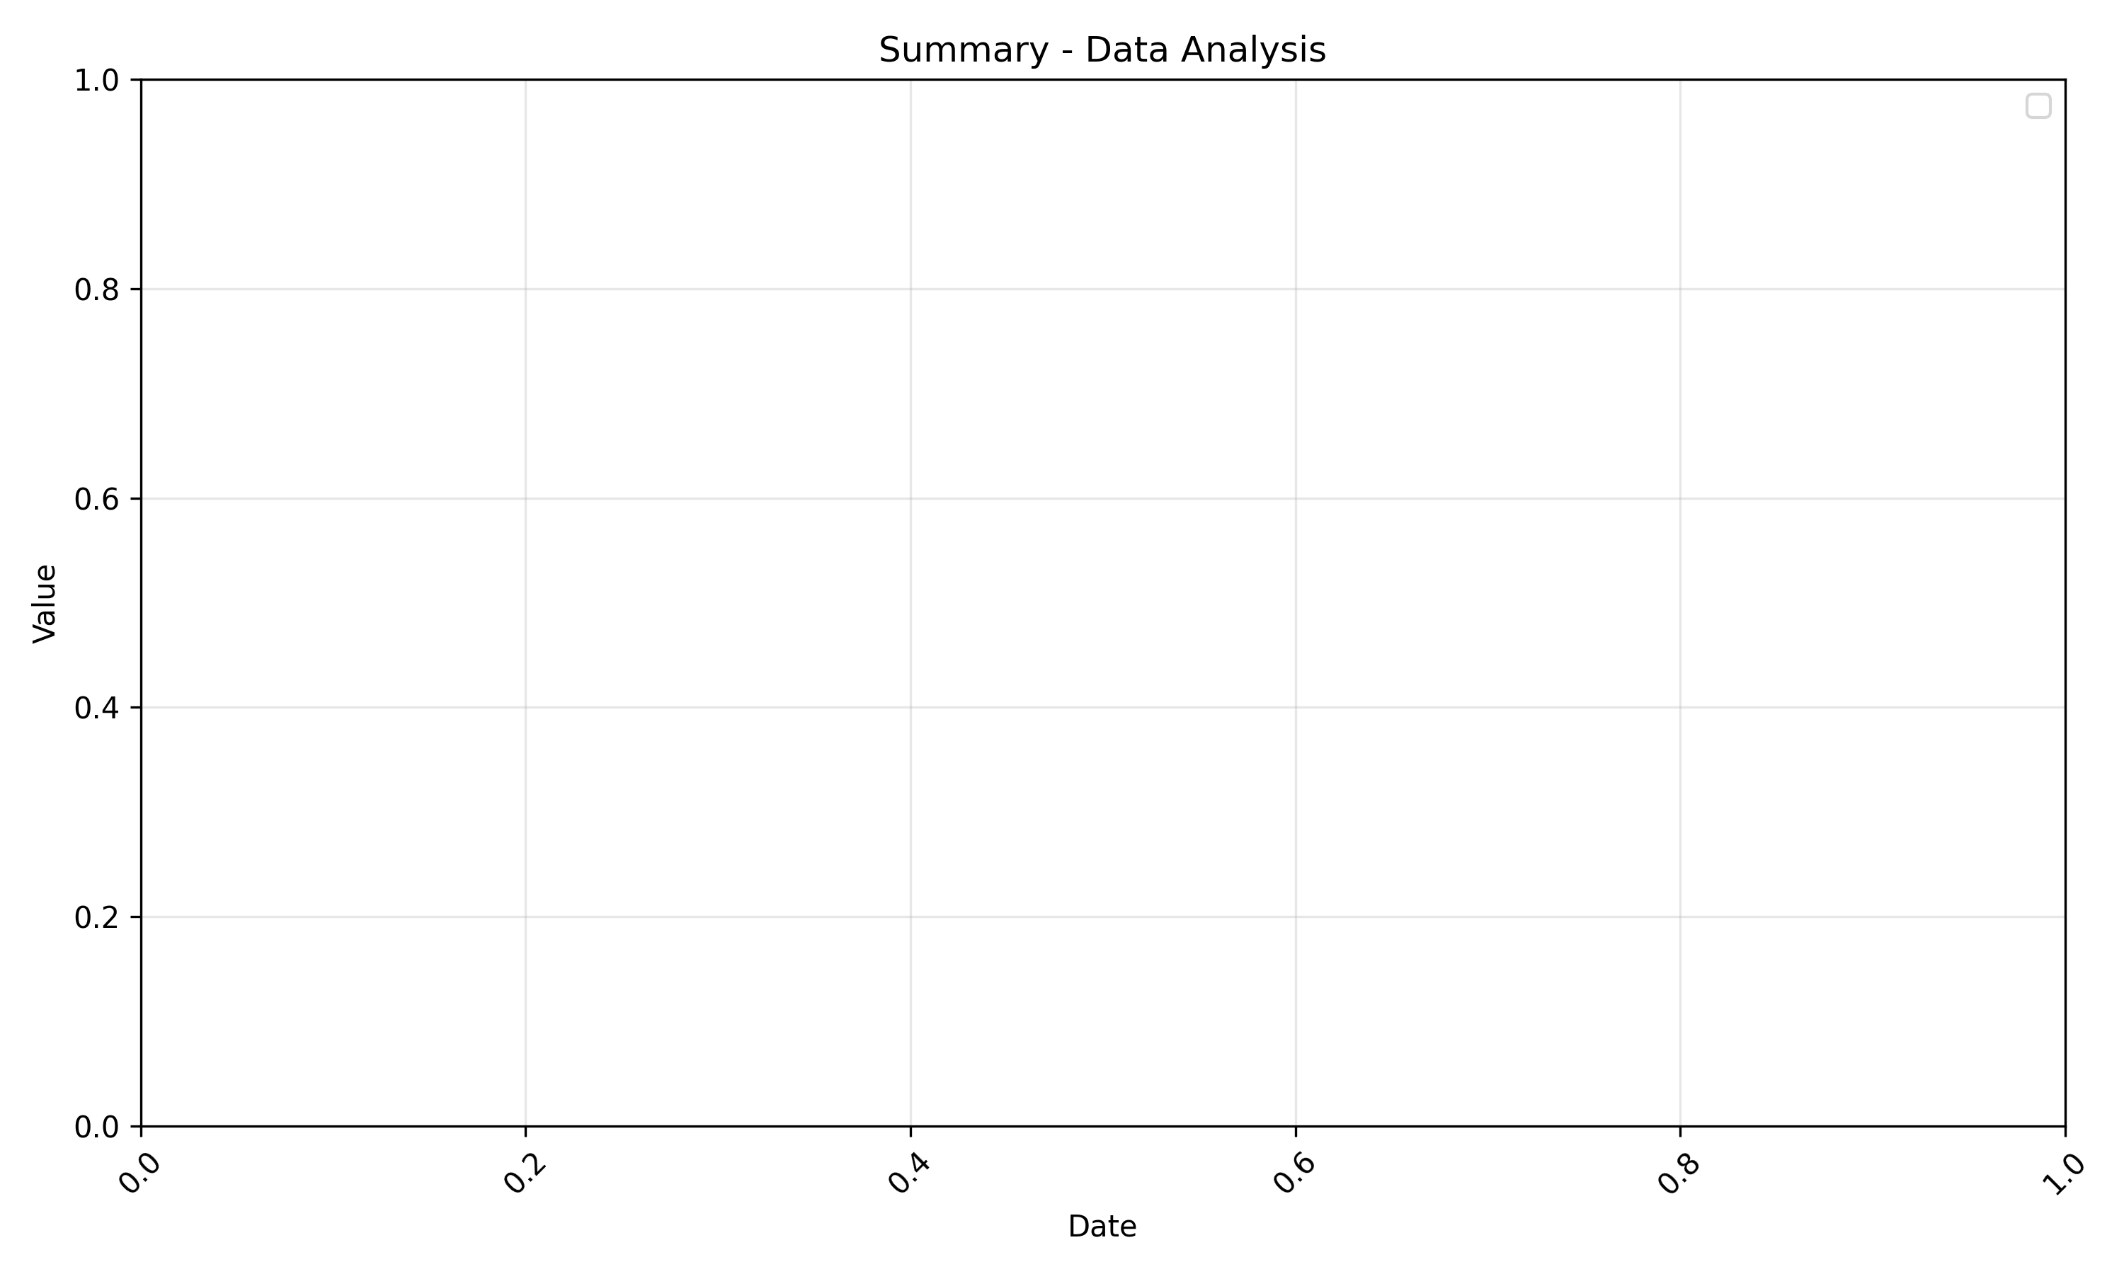
Summary - Analytics
Data analysis with historical trends and forecast

